Slide 1
Introduction to .NET

Slide 2
Contents
Overview of .NET
Building .NET applications
Demos folder:
Demos-01-Introduction

Slide 3
1. Overview of .NET
What is .NET?
Developing .NET applications
The .NET Framework
The Common Language Runtime (CLR)

Slide 4
What is .NET?
.NET is Microsoft's strategic platform for developing enterprise systems for the modern era
Web applications
Web services
Desktop applications
Mobile applications
DLL class libraries
Console applications
.NET recognizes and addresses the traditional difficulties facing application developers
Language interop (VB6, VC6, MFC, ATL, ASP, WinSDK)
Deployment difficulties (DLL hell)

Slide 5
Developing .NET Applications
.NET offers a new set of programming languages
C#
Very similar to C++ and Java
Visual Basic
An object-oriented evolution of VB6 (but quite different really!)
C++/CLI
New keywords that enable you to write C++ apps for .NET
F#
Functional programming language
Plus other languages from 3rd-party software vendors...

Slide 6
The .NET Framework
The .NET Framework provides classes etc. to assist development, and a secure runtime environment
Programming language support
C#, VB, C++/CLI, F#, plus other languages
ASP.NET
Web forms, Web services
Windows forms
Traditional Windows apps
WPF
XAML Windows apps
ADO.NET and XML
Database access and XML support
.NET Framework class library (FCL)
Extensive language-independent class library
Common Language Runtime (CLR)
Secure run time environment for all 'managed' .NET code

Slide 7
The Common Language Runtime
Provides a secure and robust execution environment for .NET 'managed code'
.NET Framework class library support
COM marshaler
Thread support
Exception manager
Type verifier
Debugger
Security manager
JIT compiler
Code manager
Garbage collector
Class loader and memory layout

Slide 8
2. Building .NET Applications
'Hello World' in various .NET languages
Compiling and running a Visual C# application
What happens during compilation?
Viewing IL
Assemblies
Creating a Windows application
Using Visual Studio 2015
Referencing assemblies

Slide 9
'Hello World'
The traditional 'Hello World' program ☺
See demo folder, Demos-01-Introduction
using System;
public class CSHelloWorld
{
public static void Main(string[] args)
{
Console.WriteLine("Hello World!");
}
} C# example, see CSHelloWorld.cs
Imports System
Module VBHelloWorld
Public Sub Main(ByVal args As String())
Console.WriteLine("Hello World!")
End Sub
End Module VB example, see VBHelloWorld.vb

Slide 10
Compiling and Running the Application
You can compile and run the app from the command line…
On the Windows Start screen…
Search for Developer Command Prompt for VS2015
To compile the code for the example:
To run the application (runs on the CLR):
csc CSHelloWorld.cs
CSHelloWorld.exe

Slide 11
What Happens During Compilation?
The .NET Framework provides a set of compilers
csc.exe is the C# compiler
vbc.exe is the Visual Basic compiler
cl.exe is the C++ compiler
Each compiler emits the same bytecode format
Intermediate Language (IL) byte codes
You can mix-and-match classes written in any .NET language
MyProg.cs
MyProg.vb
MyProg.cpp
csc.exe
vbc.exe
cl.exe
IL byte codes
IL byte codes
IL byte codes

Slide 12
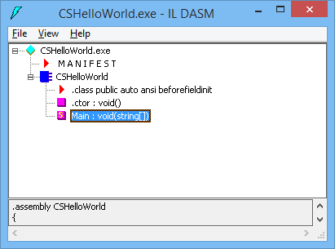
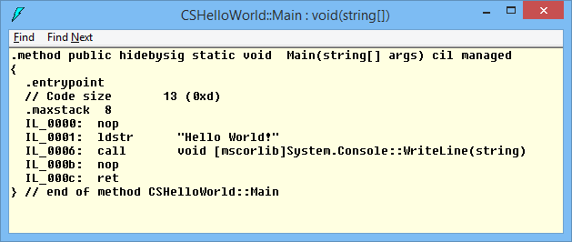
Viewing IL
You can view IL via the IL Disassembler, ildasm.exe
Enables you to view the IL byte codes in a .NET app
Helps you understand how .NET languages work
Enables you to write better .NET code
ildasm CSHelloWorld.exe

Slide 13
Assemblies
An assembly is a .DLL or .EXE containing managed code
E.g. CSHelloWorld.exe is an assembly
You can create apps that contain (or reference) many different assemblies
To illustrate how assemblies work, we'll build a simple Windows Forms application in C#
The application will reference several assemblies, such as System.Windows.Forms
Note, later in the course we'll also see how to create GUI apps using WPF and XAML

Slide 14
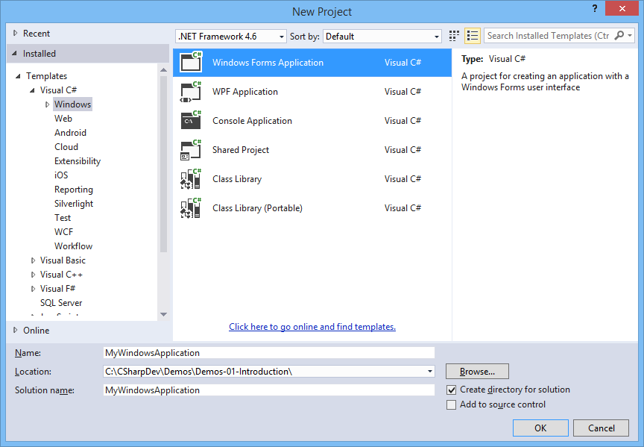
Creating a Windows Application
Start Visual Studio 2015, and create a new project:

Slide 15
Using Visual Studio 2015
Visual Studio 2015 is a single development environment for all .NET languages
Multiple project types
Multiple .NET languages
Multiple .NET versions
Integrated debugging support
Development web server for ASP.NET web apps
Integrated access to NuGet, for downloading extension packages

Slide 16
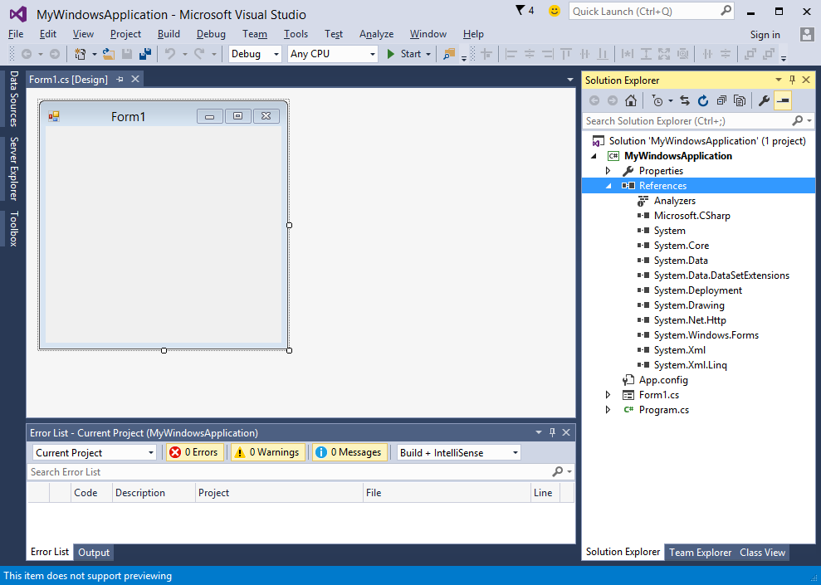
Referencing Assemblies
Expand the 'References' node in Solution Explorer
Lists the other assemblies referenced by this assembly
Several standard assemblies referenced by default
Compiler checks assemblies during compilation
CLR loads assemblies at run time

Slide 17
Any Questions?

